Slide 1
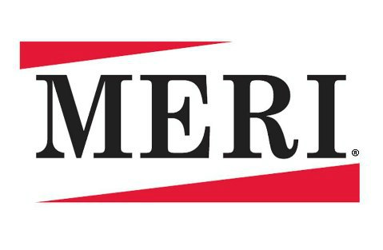
5 reasons why you should sign on the dotted line
X_______________________
Contractor Agreement
Clarifies roles and responsibilities
Can get better rates for 3-5 year contracts
Lock in price for future budgeting purposes
Often can add special provisions
Protect yourself if any legal issues arise

